Slide 1

Hamadan University of Medical Sciences
Principles of Proposal Writing
Sanaz Omidi
PhD in Epidemiology
Department of Epidemiology, School of Public Health
Sanaz.omidi91@gmail.com

Slide 2



Slide 3
Proposal Components
State of Problem
Budget
Literature Review
References
Objectives
Methods

Slide 4

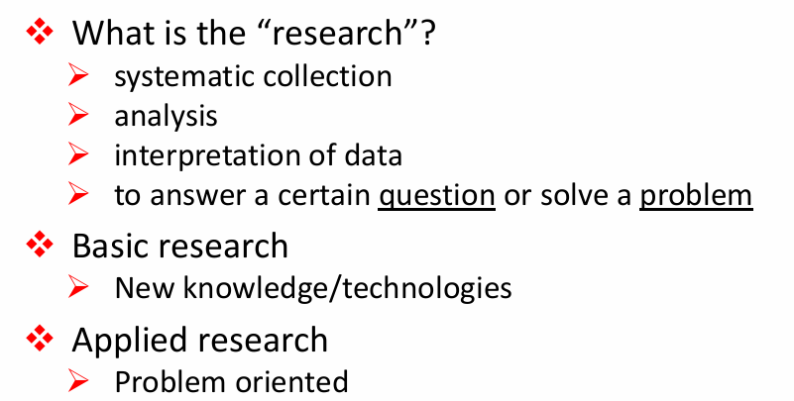

Slide 5
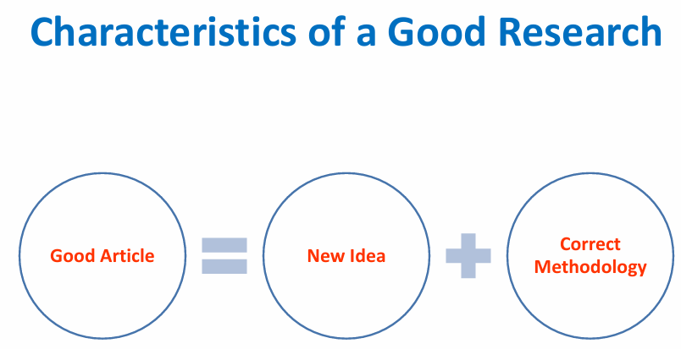

Slide 6
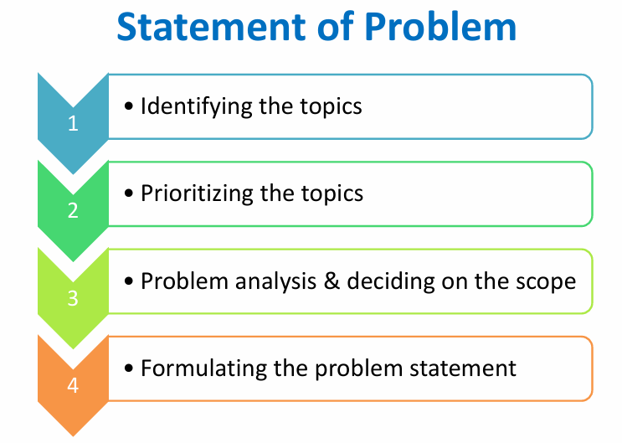

Slide 7

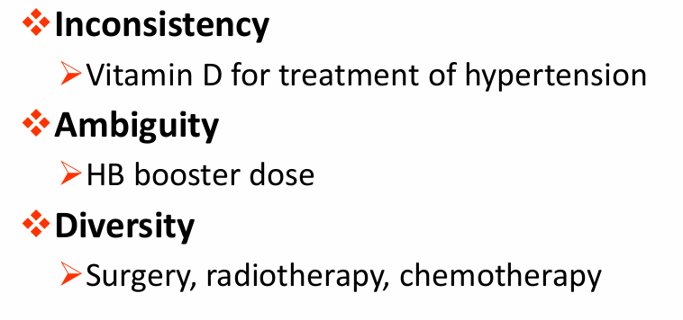

Slide 8
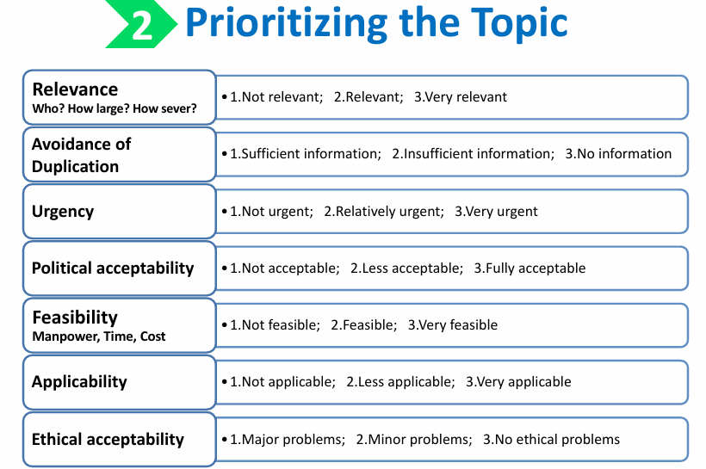

Slide 9

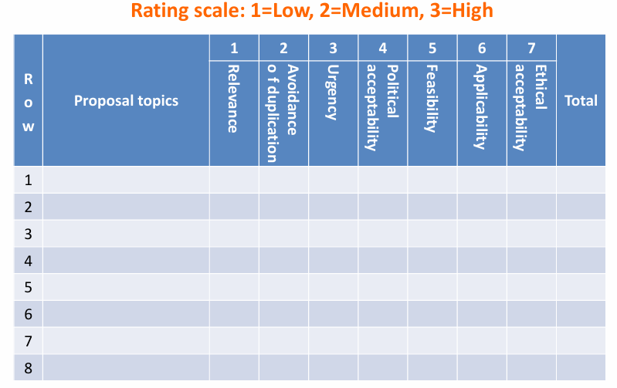

Slide 10

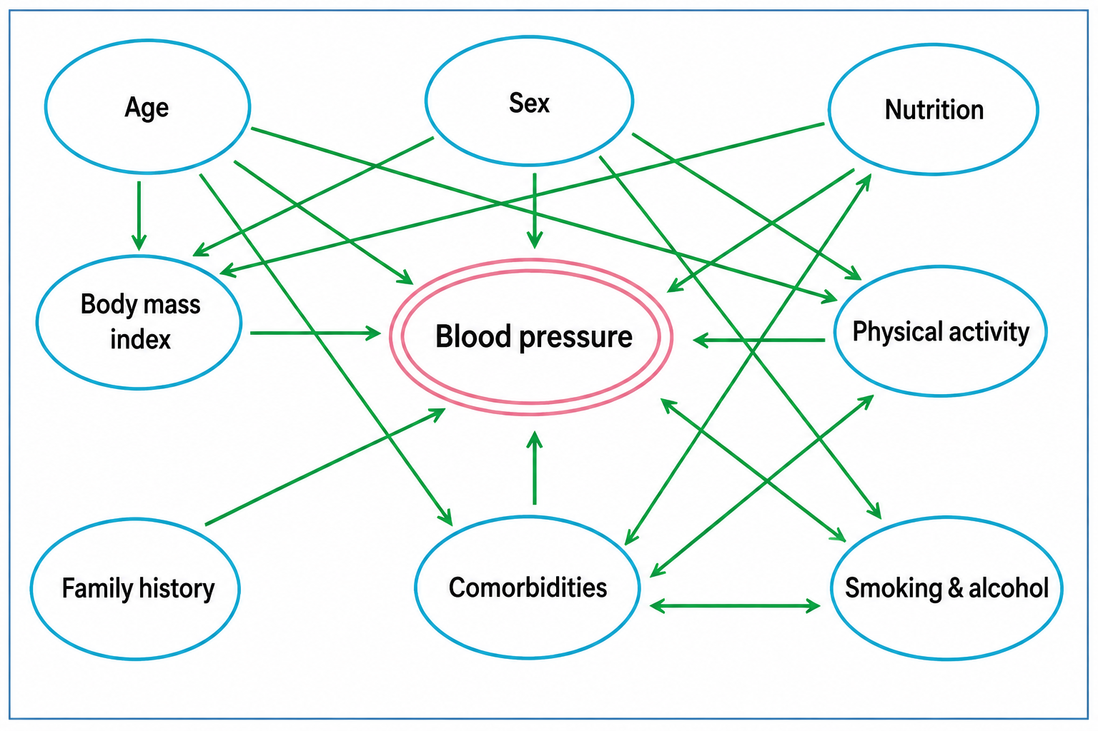

Slide 11

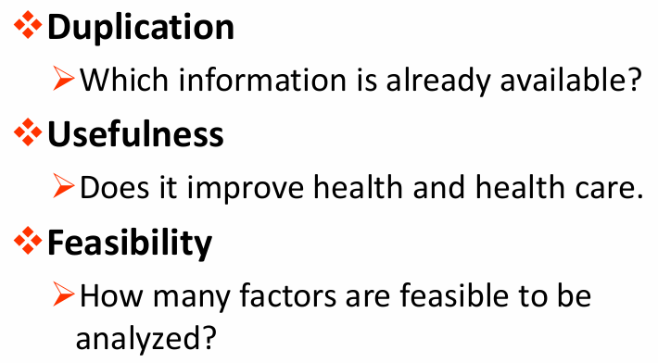

Slide 12

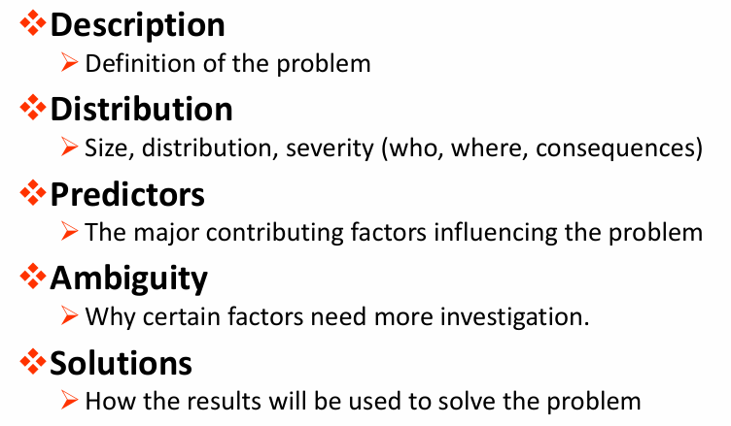

Slide 13
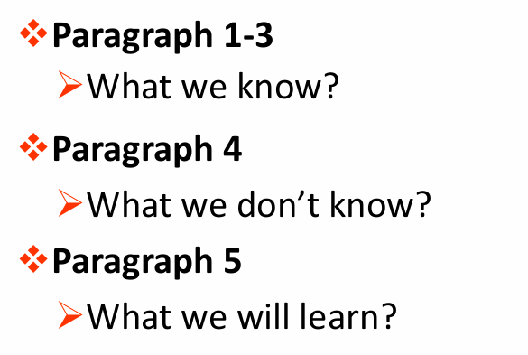

Slide 14

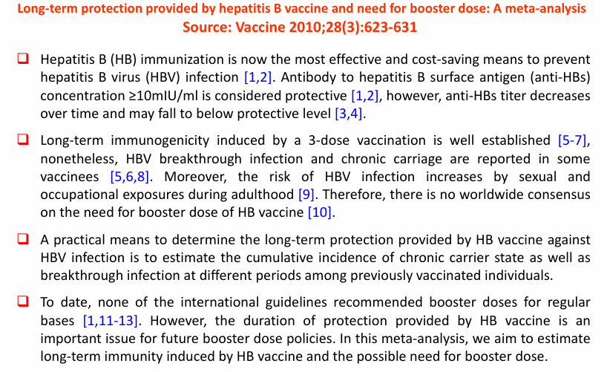

Slide 15

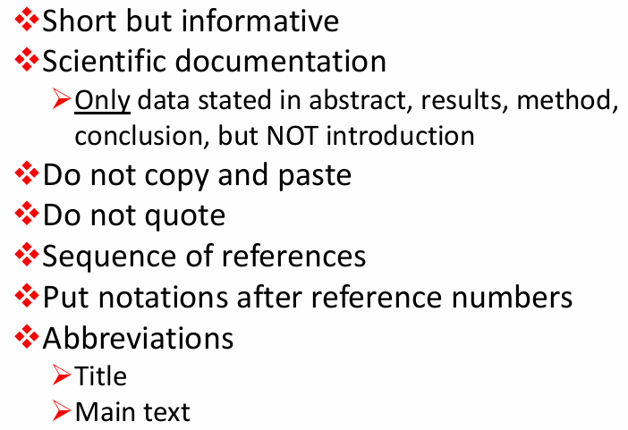

Slide 16
Proposal Components
State of Problem
Budget
Literature Review
References
Objectives
Methods

Slide 17
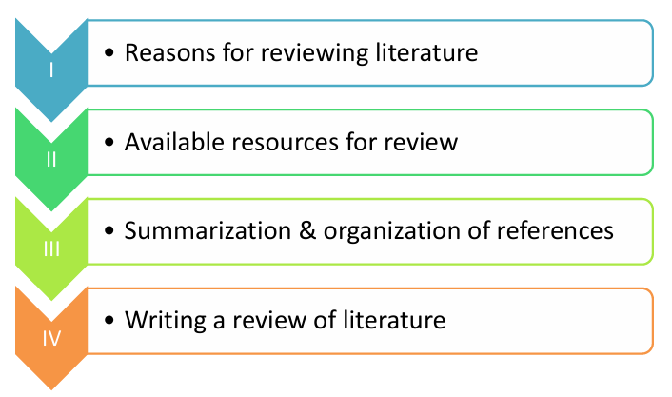

Slide 18


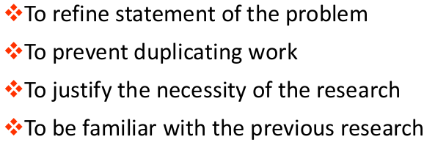

Slide 19



Slide 20

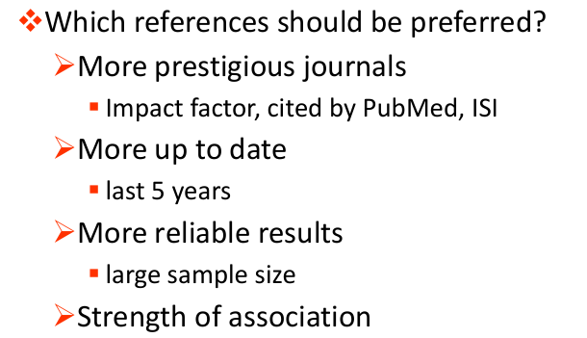

Slide 21

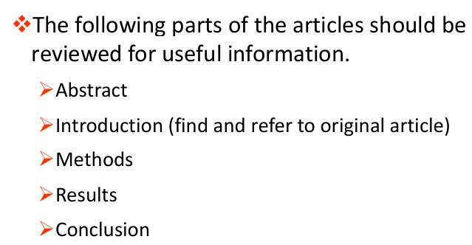

Slide 22
Key Points for Writing the Literature Review
Use recent studies published in reputable journals.
As far as possible, limit references published more than 5 years ago,
except for highly important or foundational studies.
Avoid including too many articles; usually, a maximum of 10 studies is sufficient.
When selecting sources, the quality of studies is more important than their quantity.
Unlike the problem statement, avoid citing multiple references for a single point.
Ideally, each paragraph in the literature review should focus on one study.

Slide 23
Key Points for Writing the Literature Review
Start each paragraph with the following information:
  Last name of the first author
  Study location and year of publication
  Study design (clinical trial, cohort, case–control, cross-sectional, etc.)
  Sample size
Then describe the methods, main findings, and conclusion of the study.
Include the article’s reference number at the end of each paragraph.

Slide 24

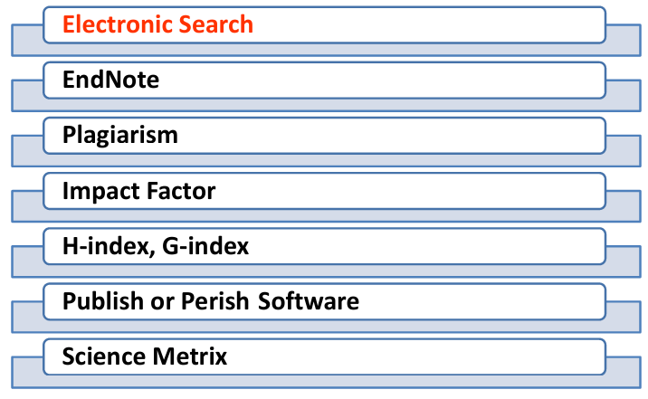

Slide 25



Slide 26

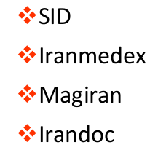


Slide 27


Slide 28

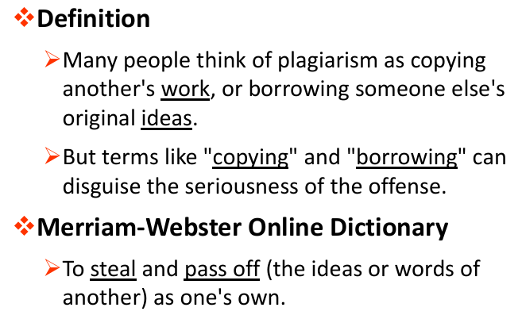

Slide 29
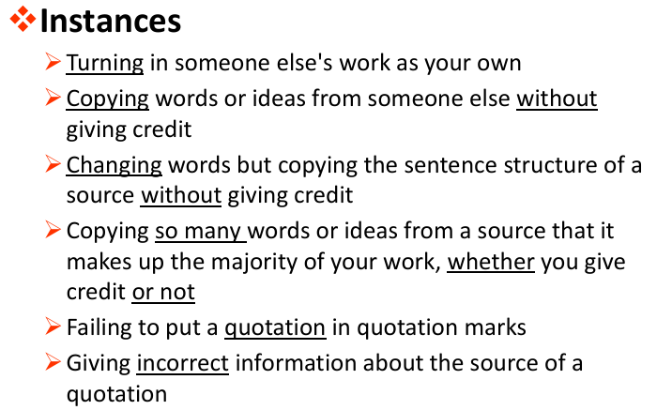

Slide 30
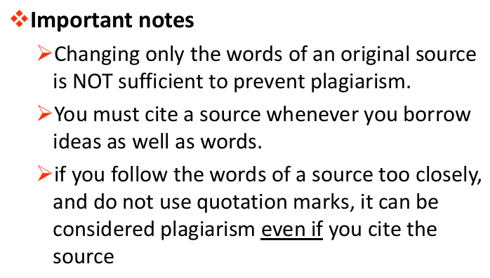

Slide 31
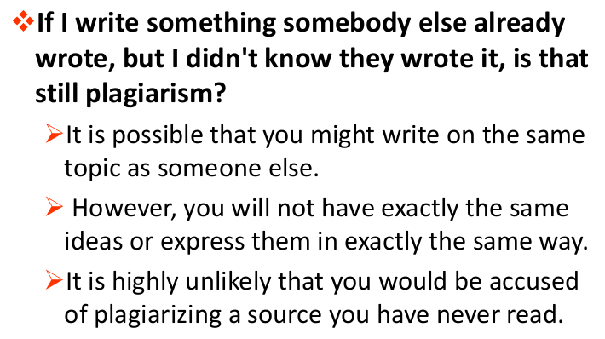

Slide 32
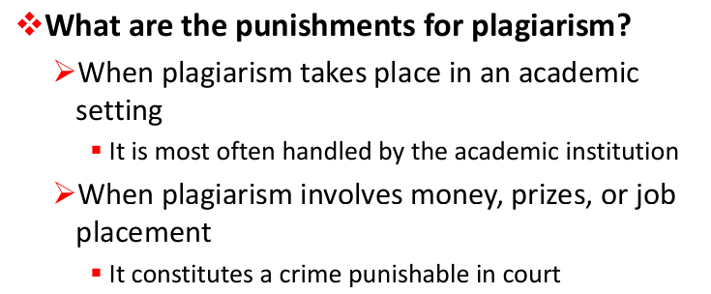

Slide 33

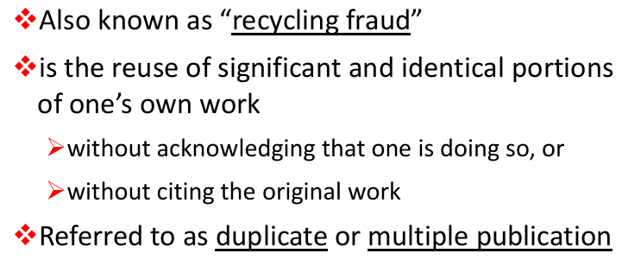

Slide 34
Proposal Components
State of Problem
Budget
Literature Review
References
Objectives
Methods

Slide 35

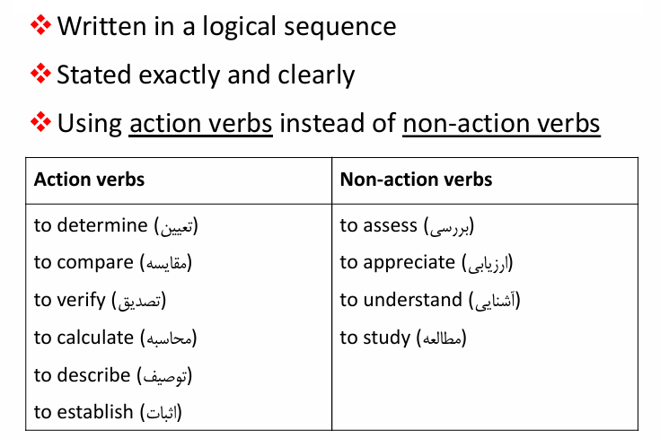

Slide 36

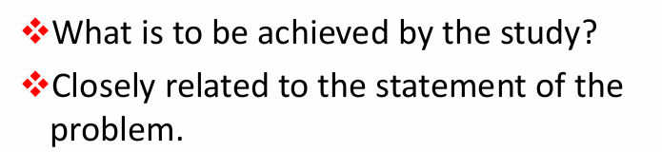
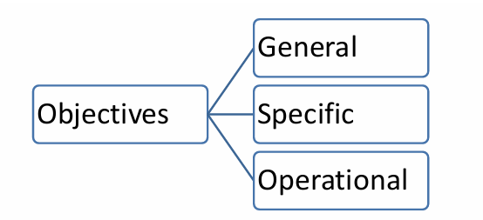

Slide 37

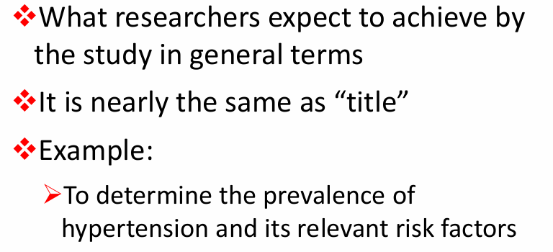

Slide 38

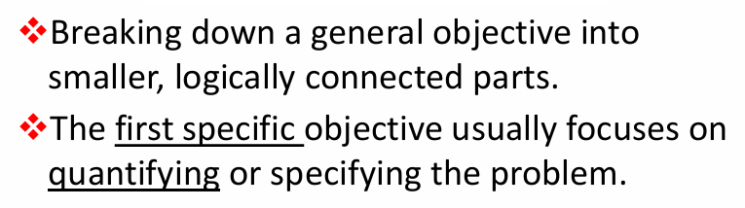
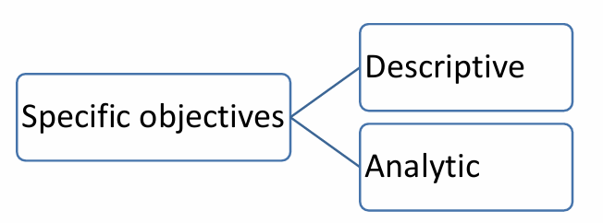

Slide 39

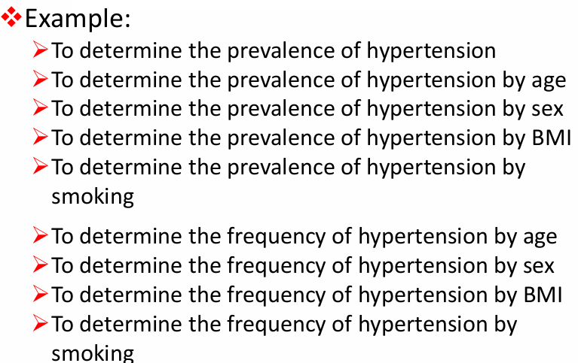

Slide 40

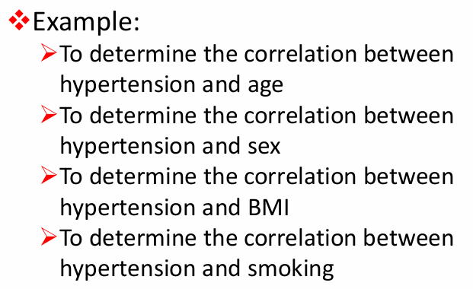

Slide 41

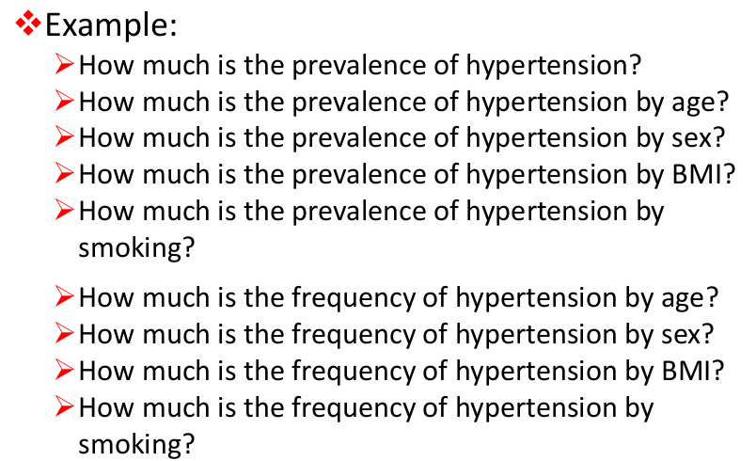

Slide 42

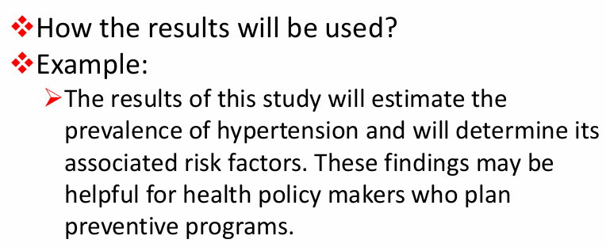

Slide 43

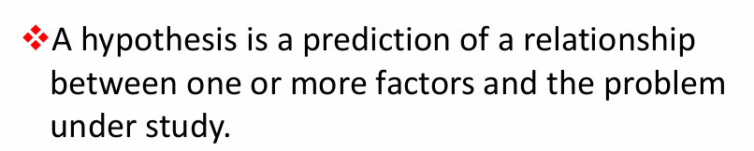
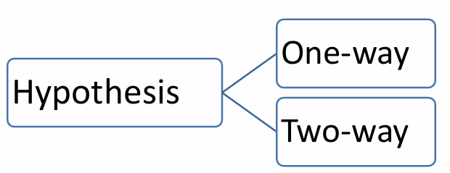

Slide 44

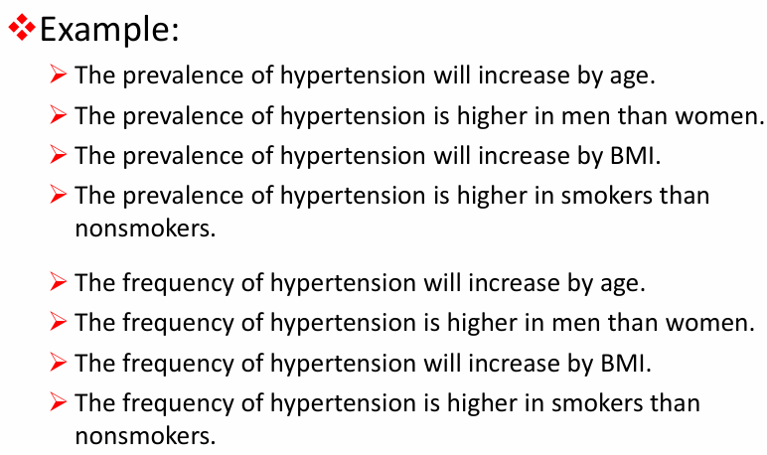

Slide 45

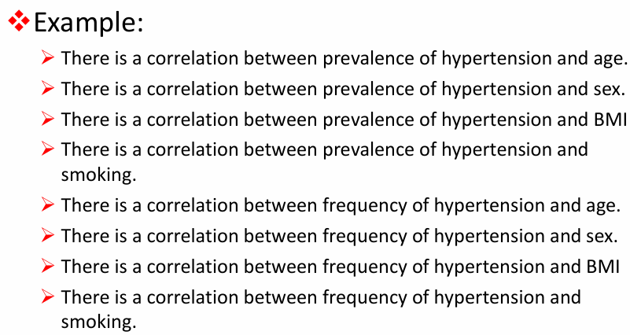

Slide 46
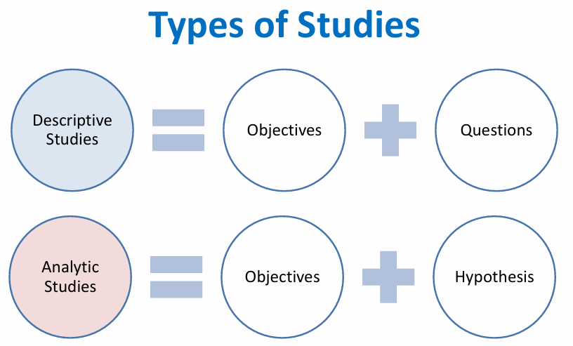

Slide 47

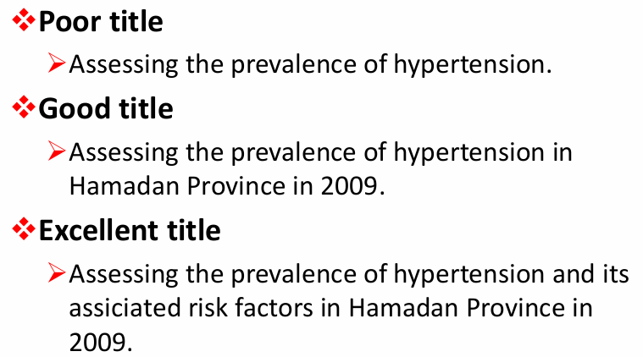

Slide 48
Proposal Components
State of Problem
Budget
Literature Review
References
Objectives
Methods

Slide 49

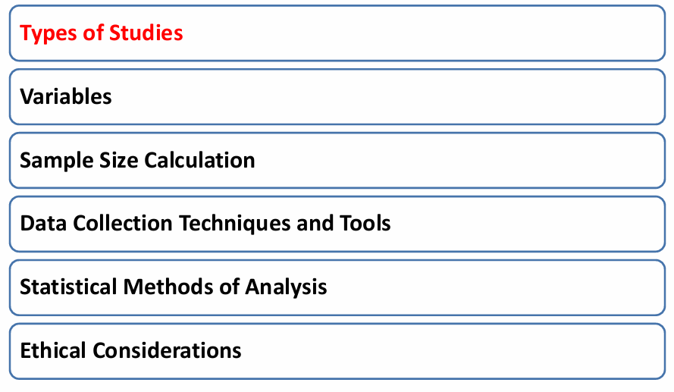

Slide 50
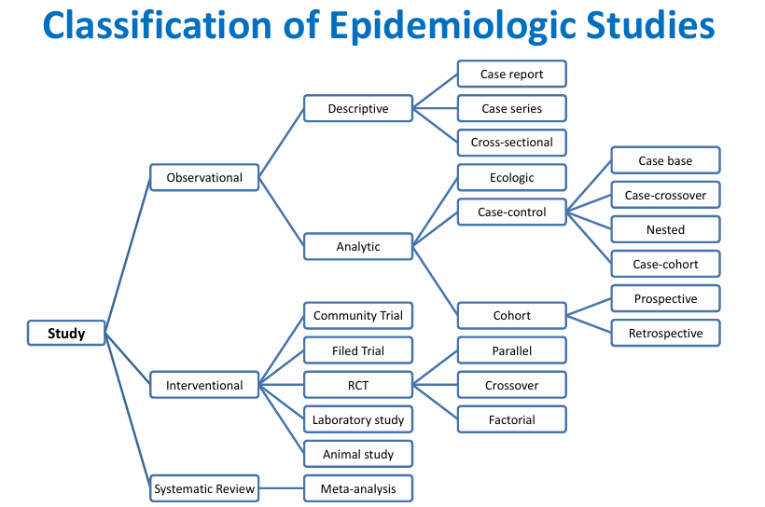

Slide 51
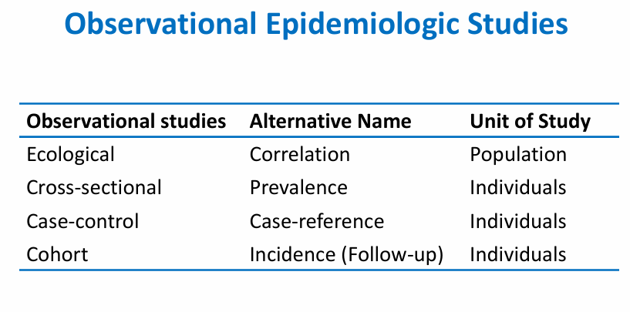

Slide 52
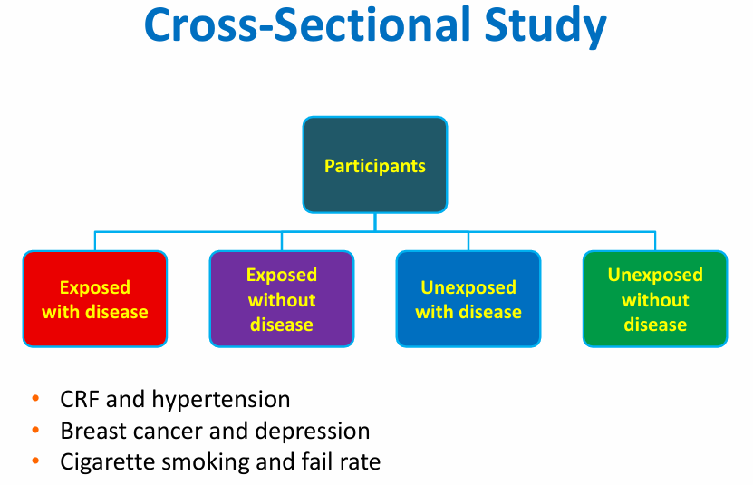

Slide 53
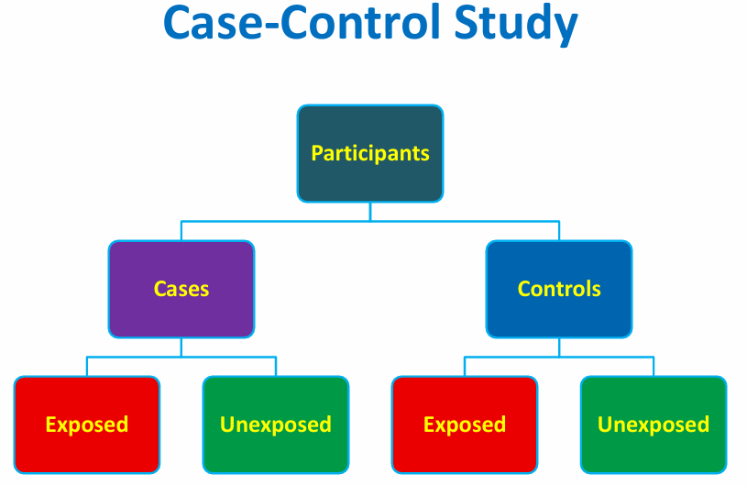

Slide 54
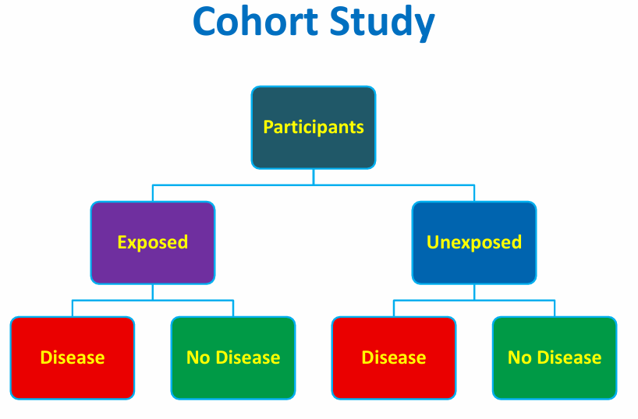

Slide 55
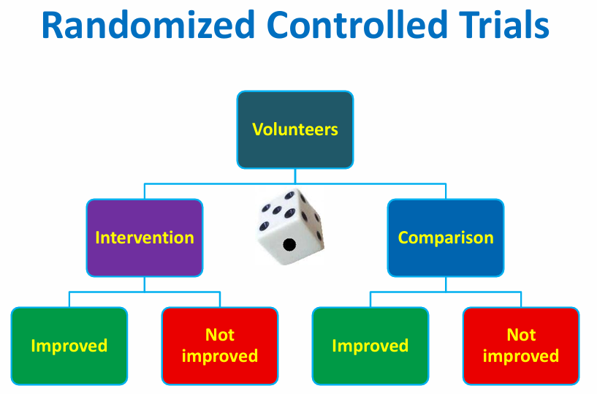

Slide 56
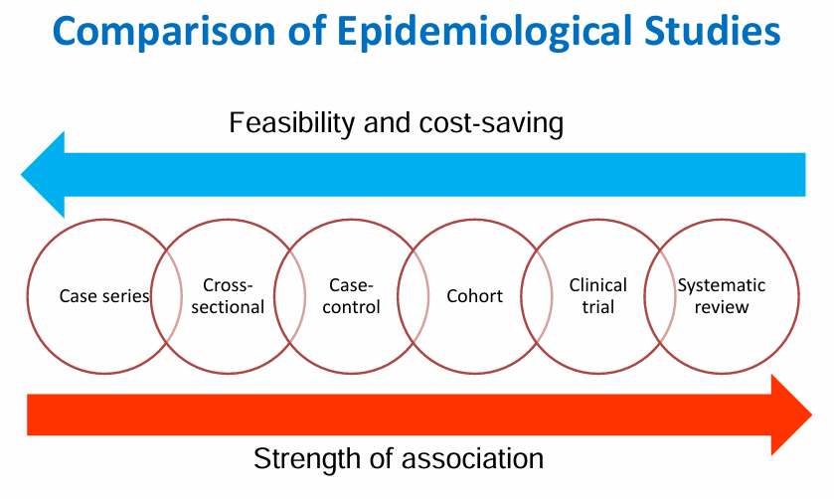

Slide 57

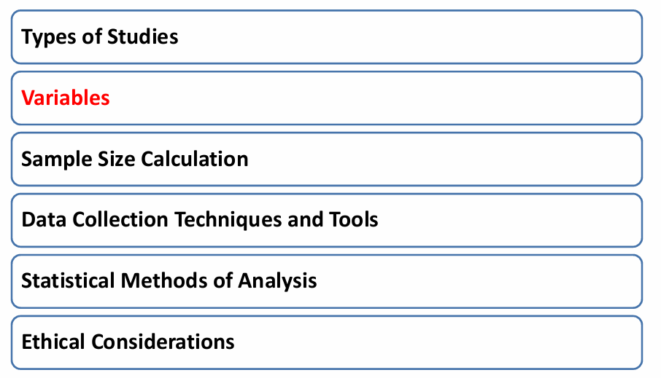

Slide 58

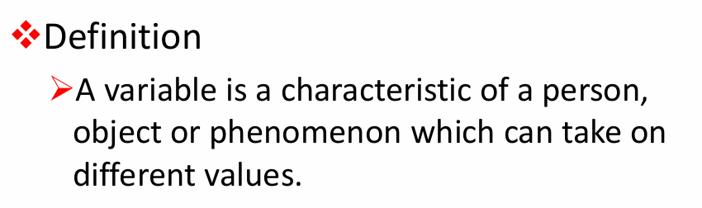

Slide 59


Slide 60



Slide 61



Slide 62


Slide 63


Slide 64


Slide 65


Slide 66


Slide 67


Slide 68



Slide 69



Slide 70



Slide 71


Slide 72



Slide 73



Slide 74


Slide 75


Slide 76


Slide 77


Slide 78


Slide 79


Slide 80



Slide 81


Slide 82



Slide 83


Slide 84



Slide 85



Slide 86



Slide 87



Slide 88


Slide 89


Slide 90


Slide 91


Slide 92



Slide 93



Slide 94


Slide 95



Slide 96



Slide 97


Slide 98


Slide 99


Slide 100


Slide 101



Slide 102



Slide 103


Slide 104


Slide 105


Slide 106


