Slide 1
Introduction to EndNote
Ghasem Azarian
PhD in Environmental Health Engineering
Hamadan University of Medical Sciences

Slide 2
What is EndNote? Reference management
Mendeley: a free reference manager and an academic social network
Zotero: a powerful, easy-to-use research tool
Refworks: online bibliographic management program
EndNote: an industry standard software tool
On the Windows
On the Web

Slide 3
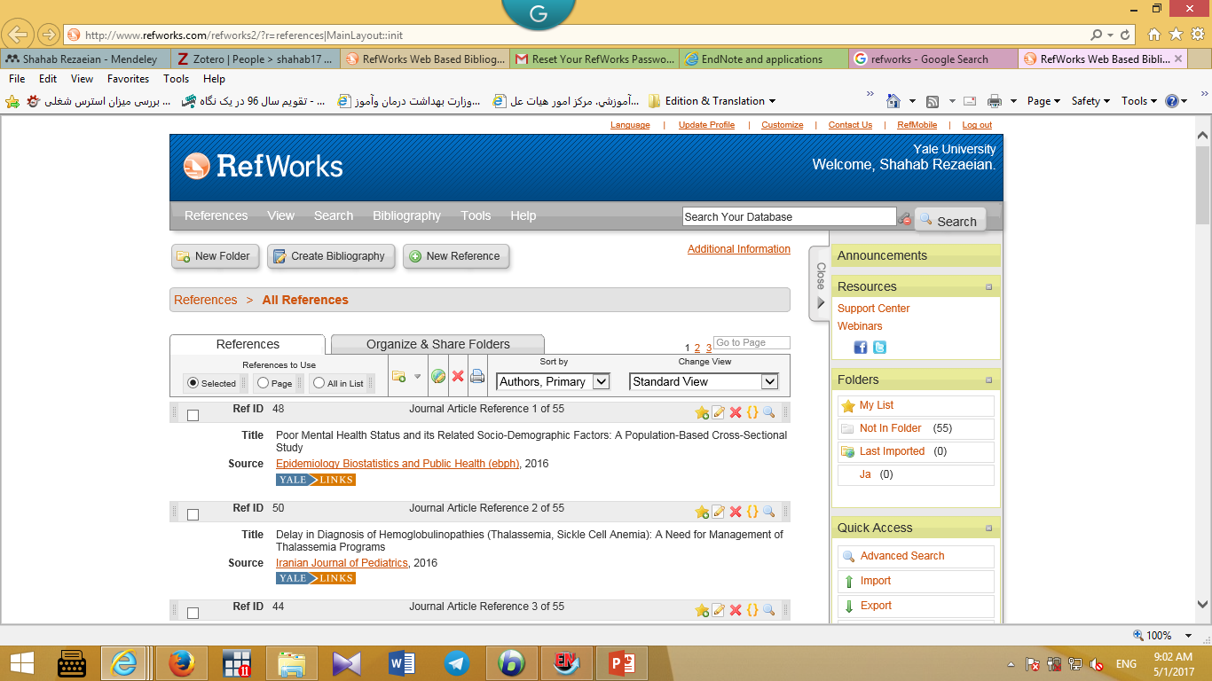

Slide 4
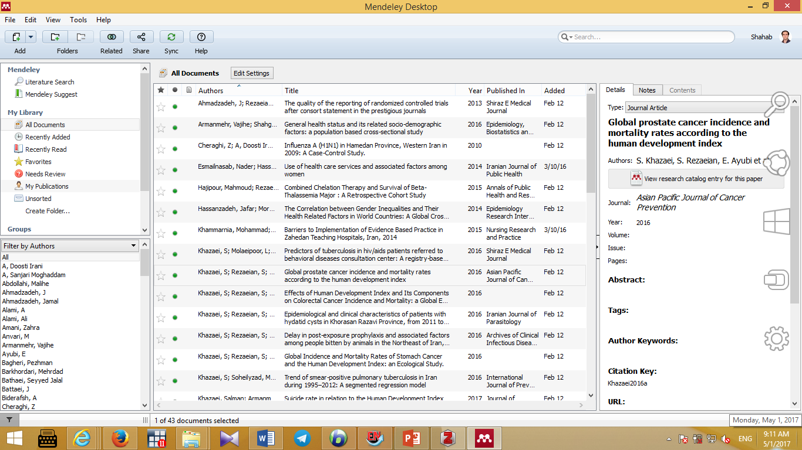

Slide 5
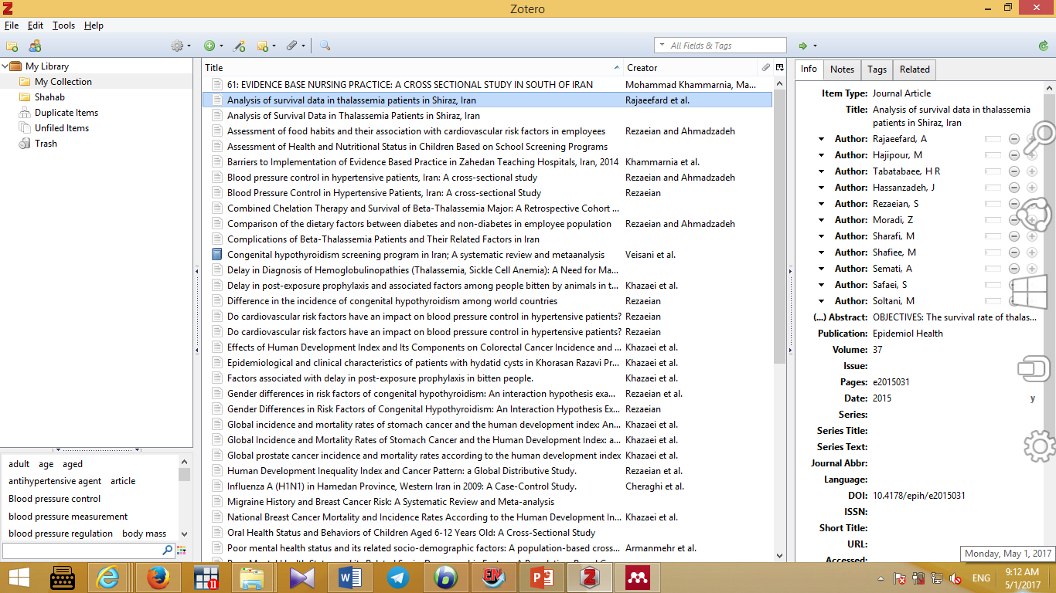

Slide 6
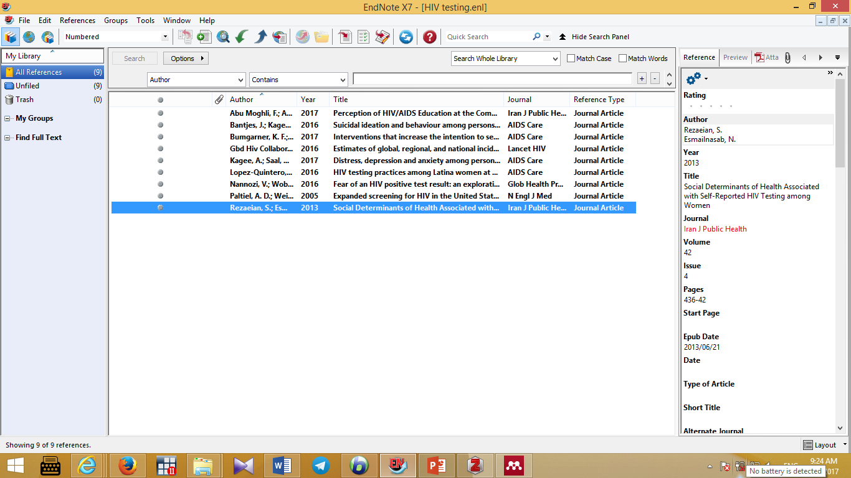

Slide 7
Endnote allows you to:
Store all the references that you find during your research:
Manually
Downloaded from most databases
Store PDF files, pictures, graphs, tables, etc.
Add citations to your work and create bibliographies

Slide 8
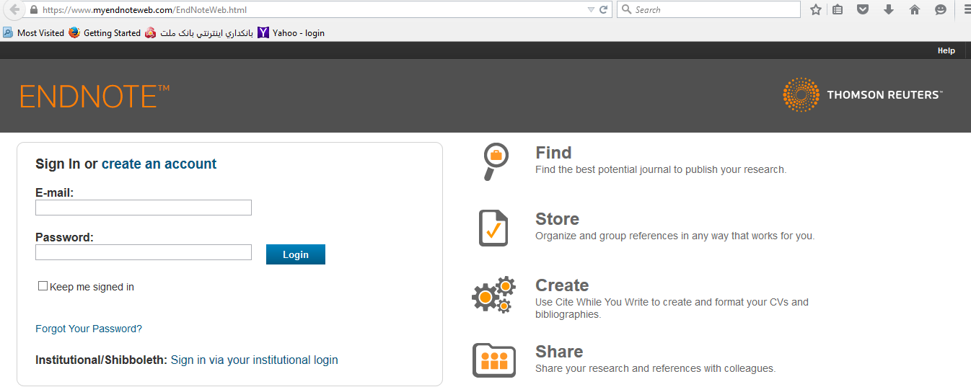

Slide 9
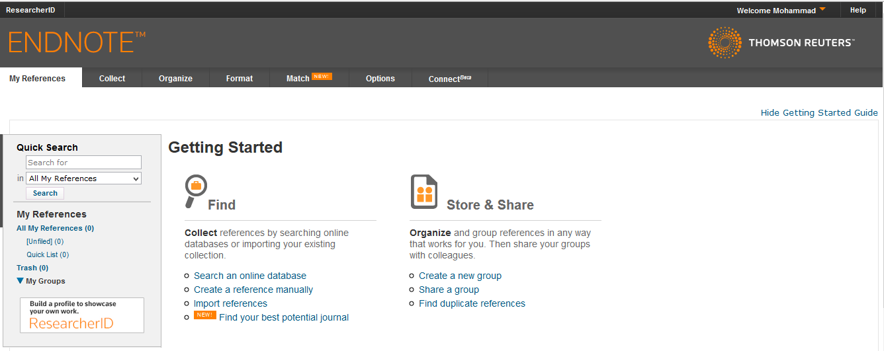

Slide 10
Part 2 : The EndNote Library

Slide 11
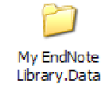

EndNote libraries
Endnote references are stored in a database called a library
Endnote libraries have the file extension .Enl.
Each library has a corresponding folder with the extension .Data.
This folder will have the same name as the library, and it is where images, PDF files, etc. are stored
If you move, copy, rename or delete a library remember to do the same with its corresponding .Data folder

Slide 12
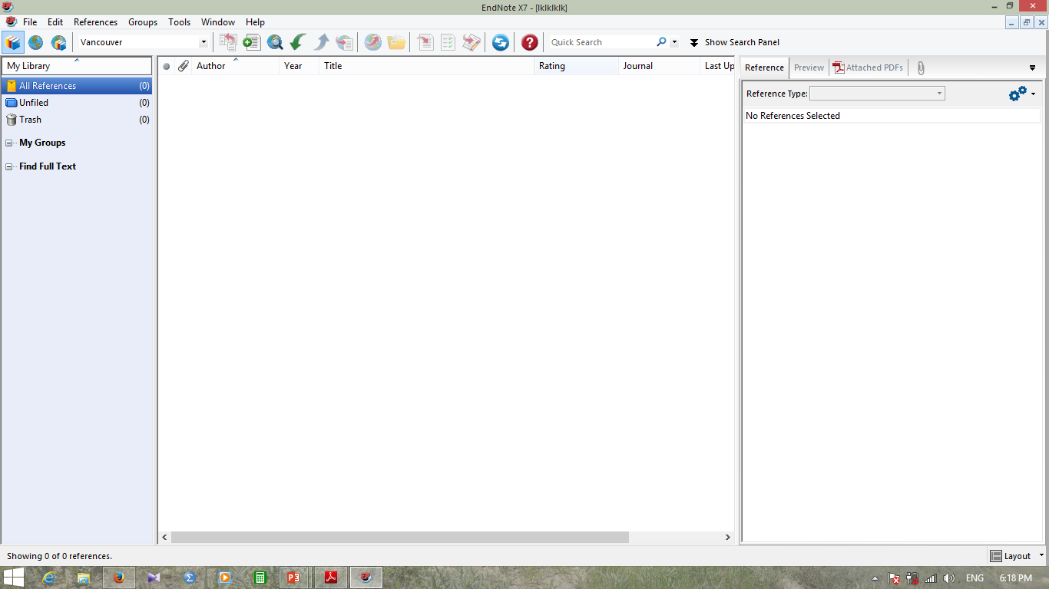

Slide 13
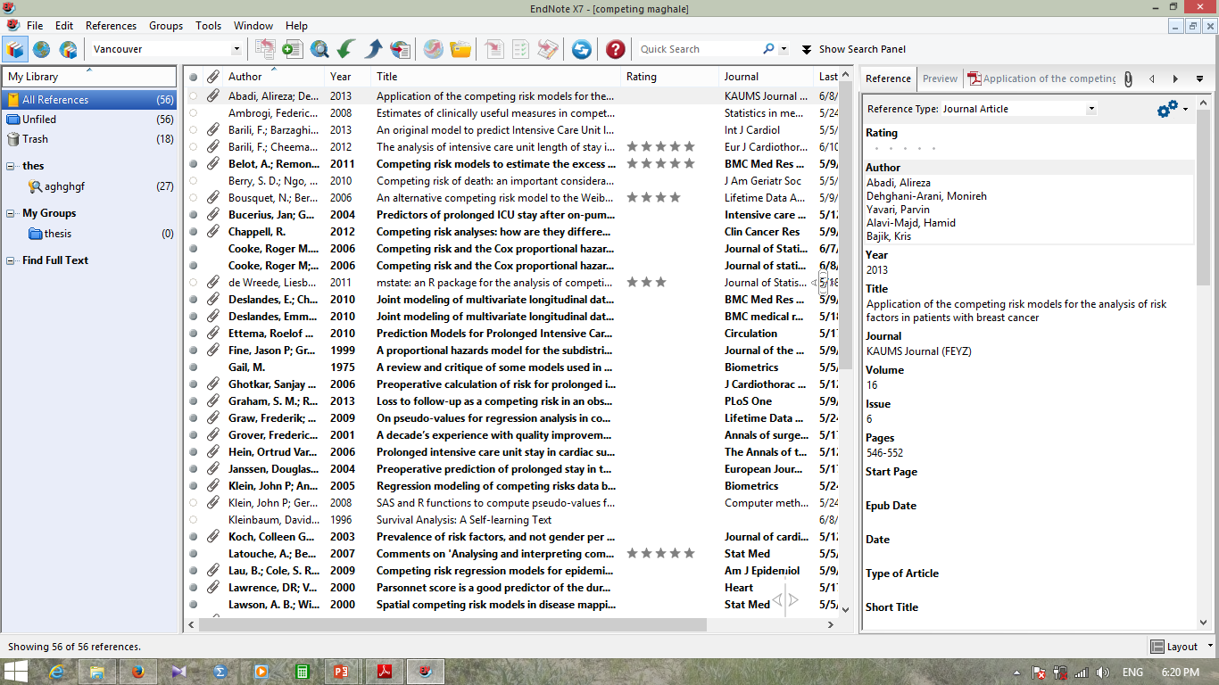

Slide 14
There is no limit to the number of references you can store in a library, although it is recommended that you do not exceed 100,000 to maintain efficient performance of the database.
When we have unregistered EndNote, only 10 ref.

Slide 15
Exporting citations from Databases into Endnote

Slide 16
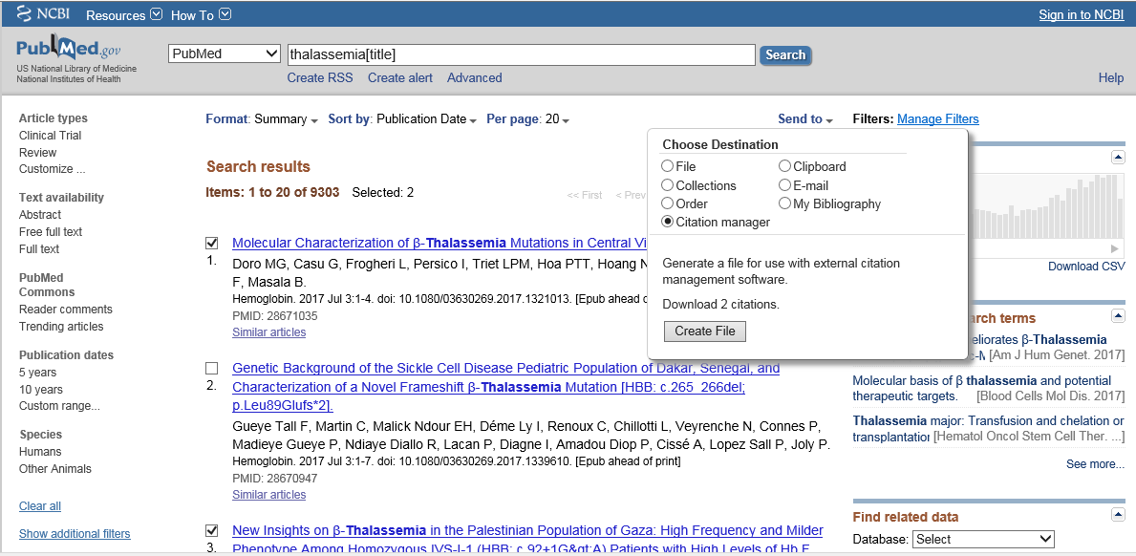

Slide 17
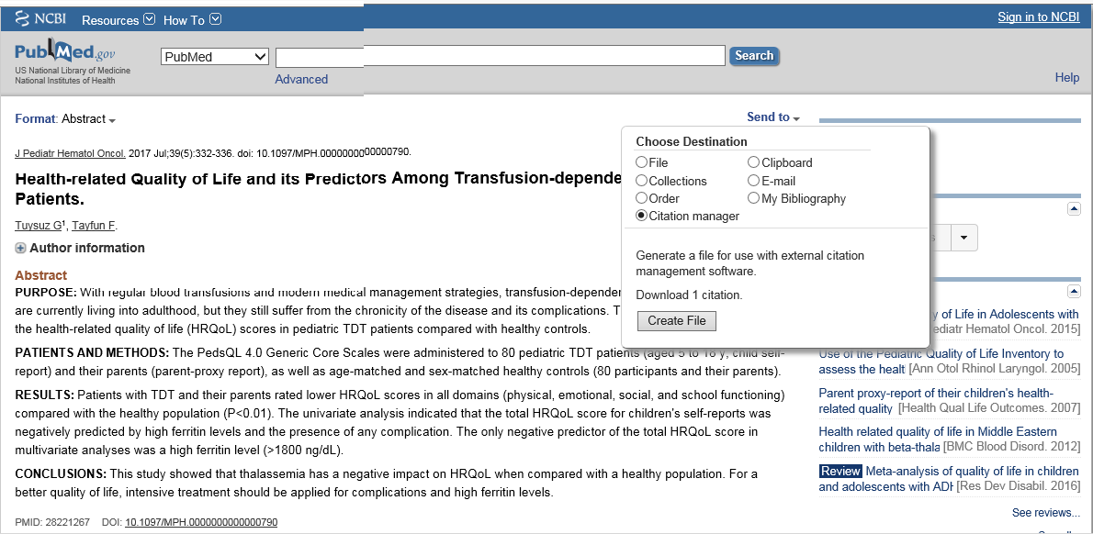

Slide 18
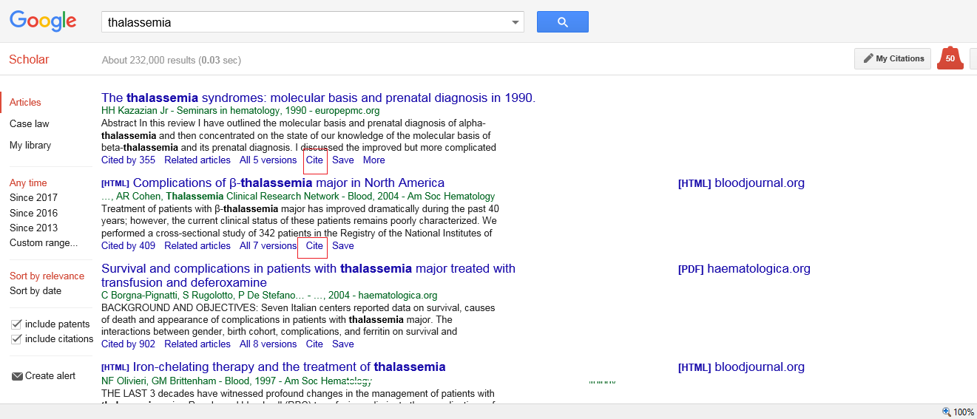

Slide 19
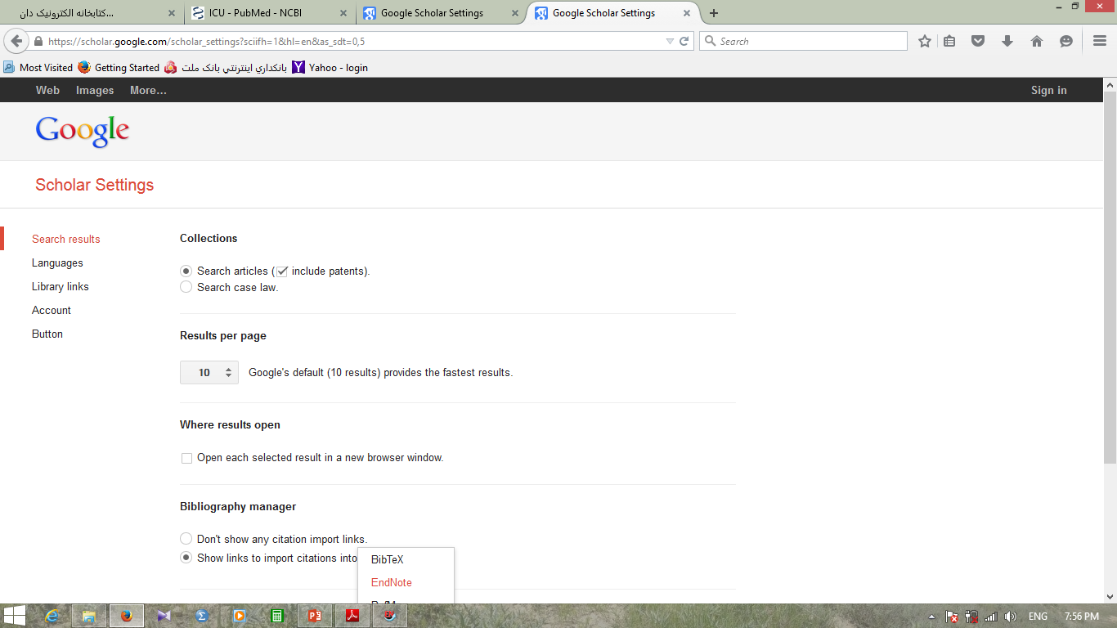

Slide 20
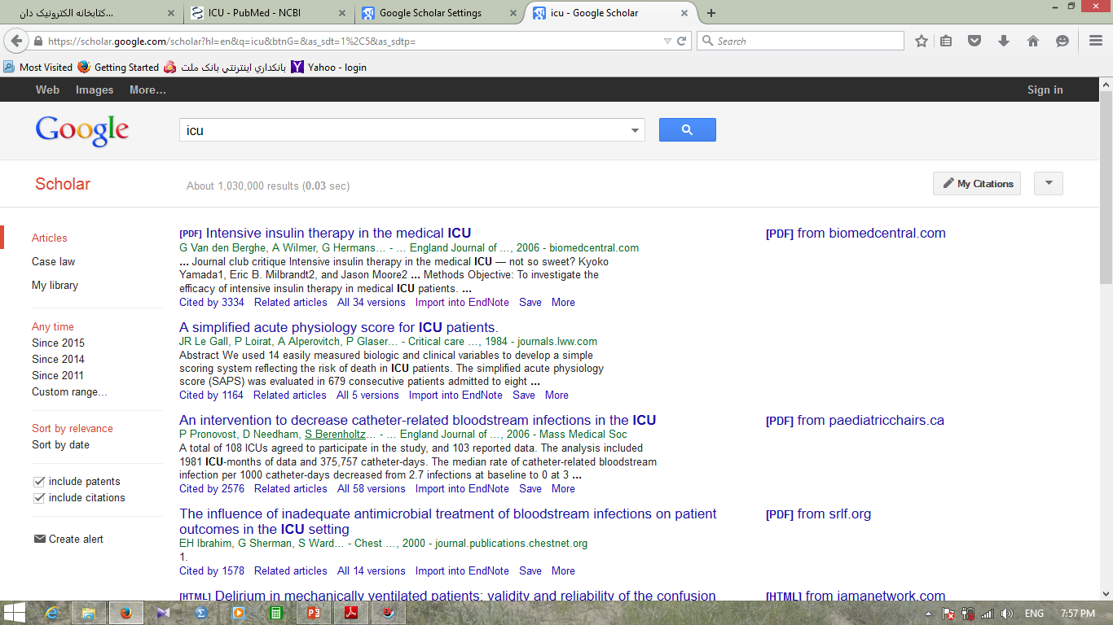

Slide 21
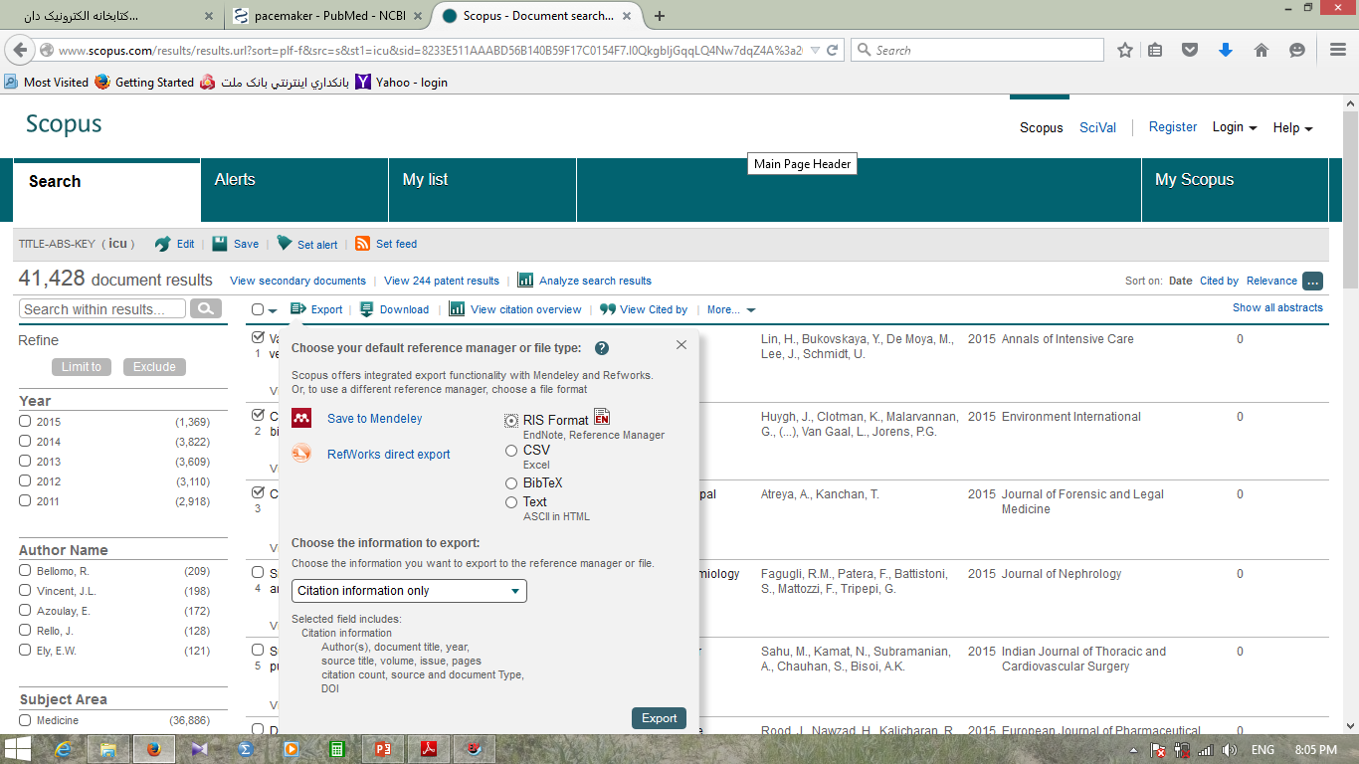

Slide 22
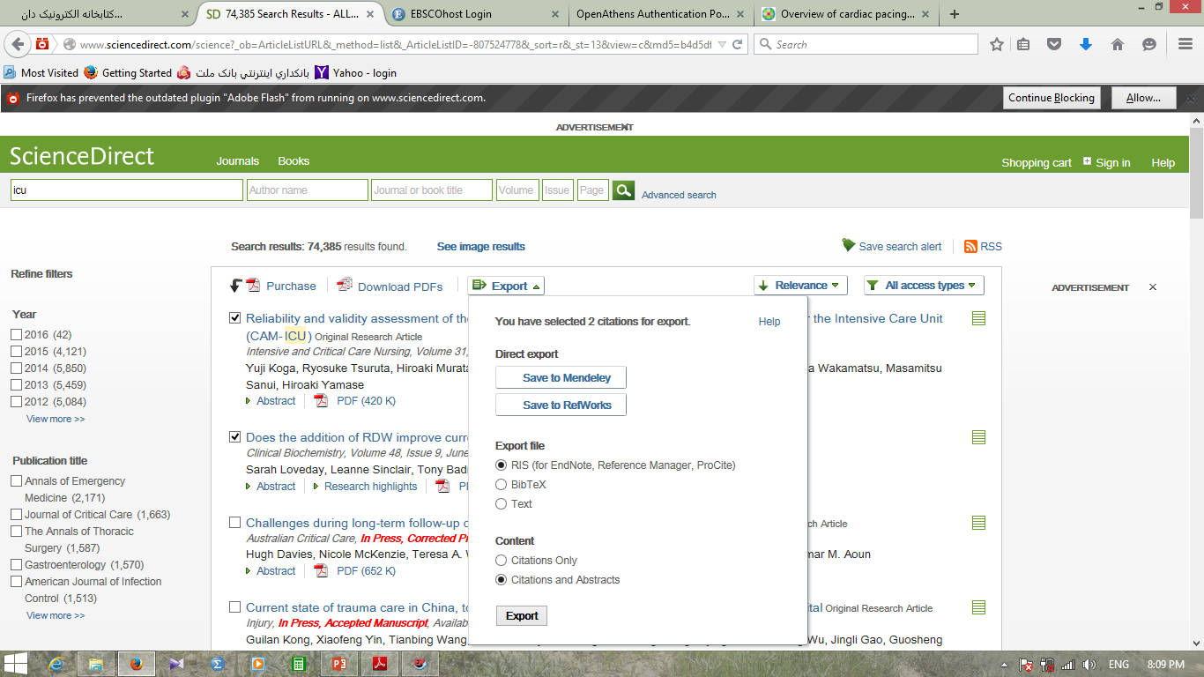

Slide 23
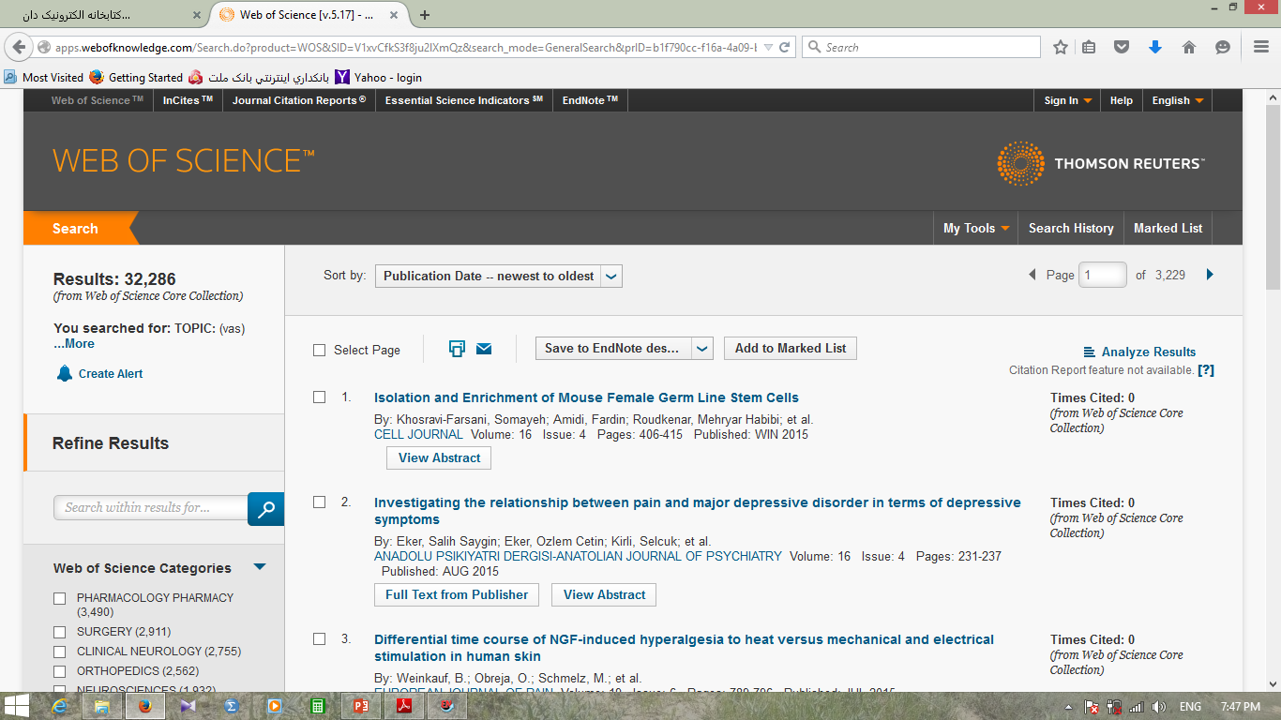

Slide 24
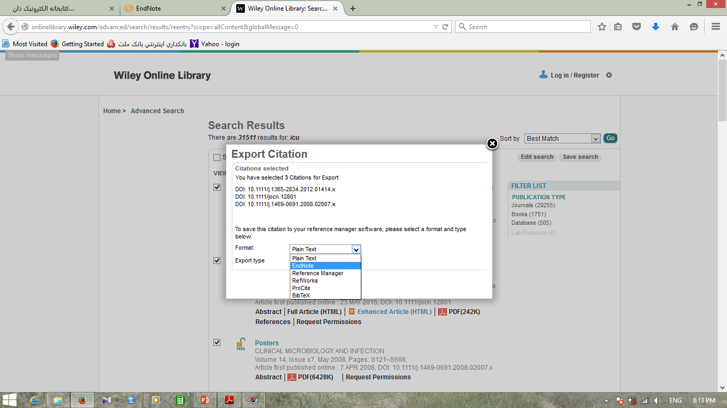

Slide 25
Inserting citations & bibliographies into a document
1. Open your endnote library
2. Open the word document
3. In the document click the place where you wish to place a citation in the text

Slide 26
4. Click the go to endnote button.
This will open your endnote library
5. Click once to highlight the reference you want to use
6. Click the insert citation button
7. Return to your word document
8. Select the style you want from the menu

Slide 27
More Information about …
Editing citations
Adding multiple citations
Deleting citations
Hyperlink Citations in a Bibliography
Font and paragraph formatting in Endnote Bibliography References
Import PDF file into EndNote
Reference style based on the Journal format
How to find duplicated citations in the text

Slide 28
Citation into PowerPoint

Slide 29
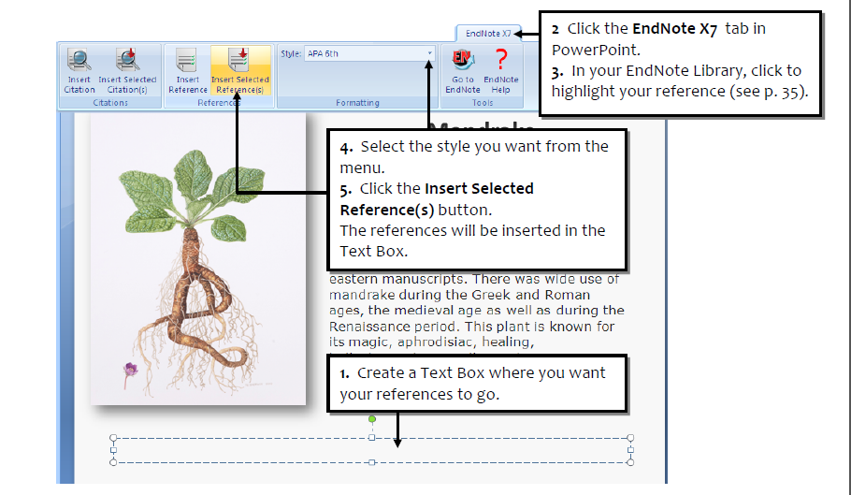

Slide 30
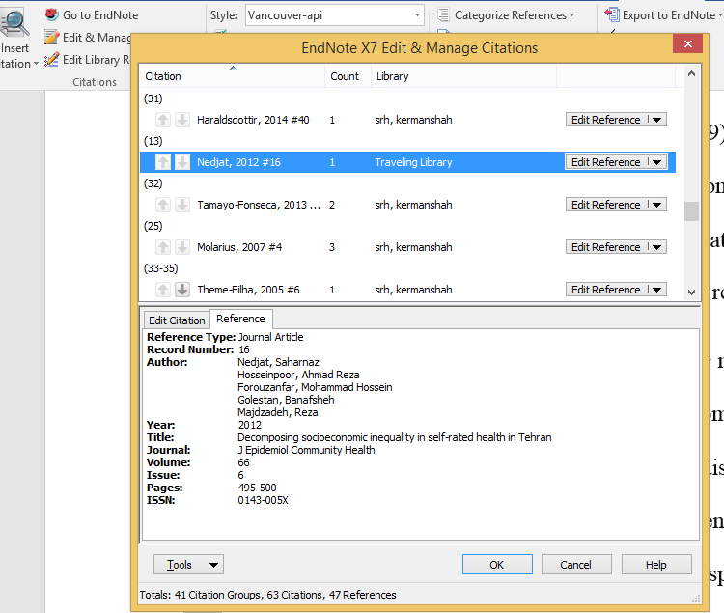
How to find duplicated citations in the text

Slide 31

Thanks for your attention

